Slide 1
WhtThePhish!
A Phishing Game Webapp
Project for CS308: Large Applications Practicum
Made by: Group-4
Rohan Raj Kansal (B19108)
Prashant Kumar (B19101)
Priyanshu Shubham (B19187)
Sourav Sehgal (B19059)
Shashwat Singh (B19056)
Ravi Kumar (B19191)
Pritish Chugh (B19187)

Slide 2
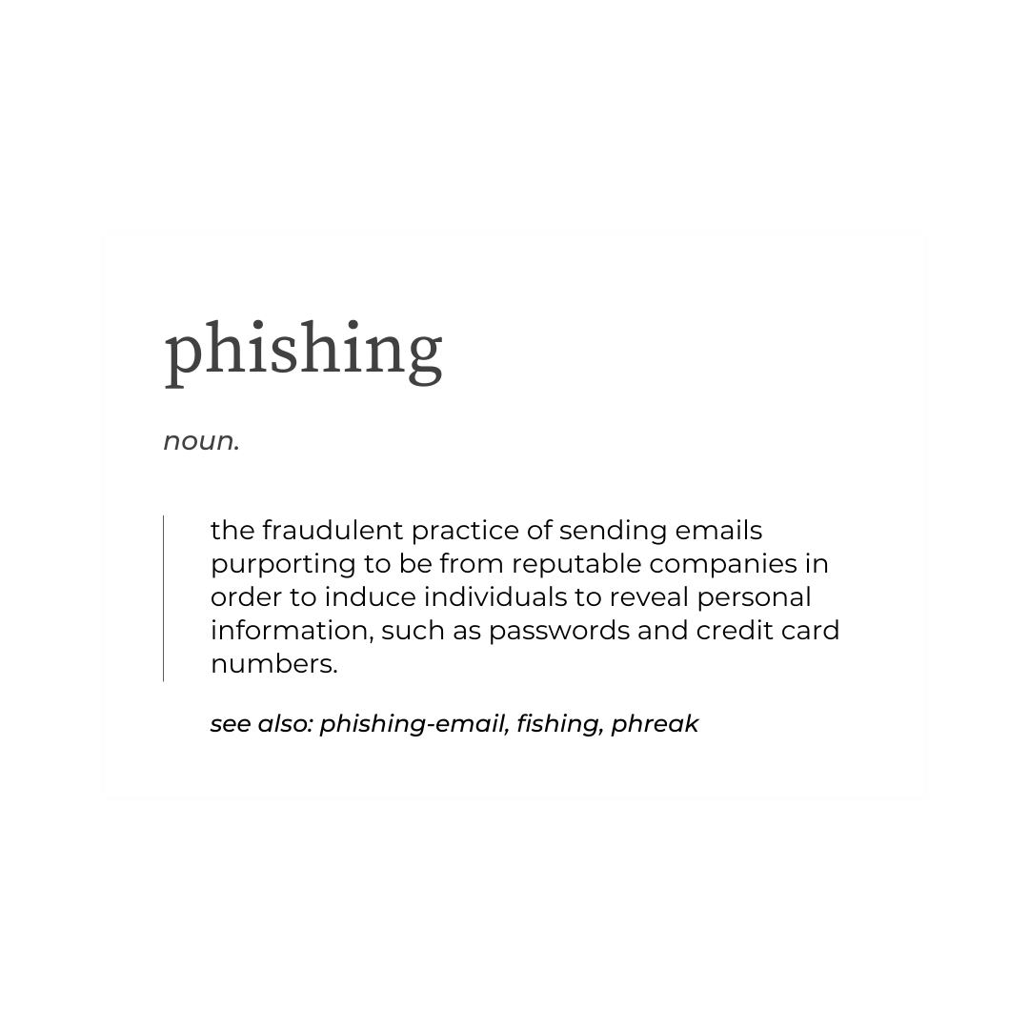
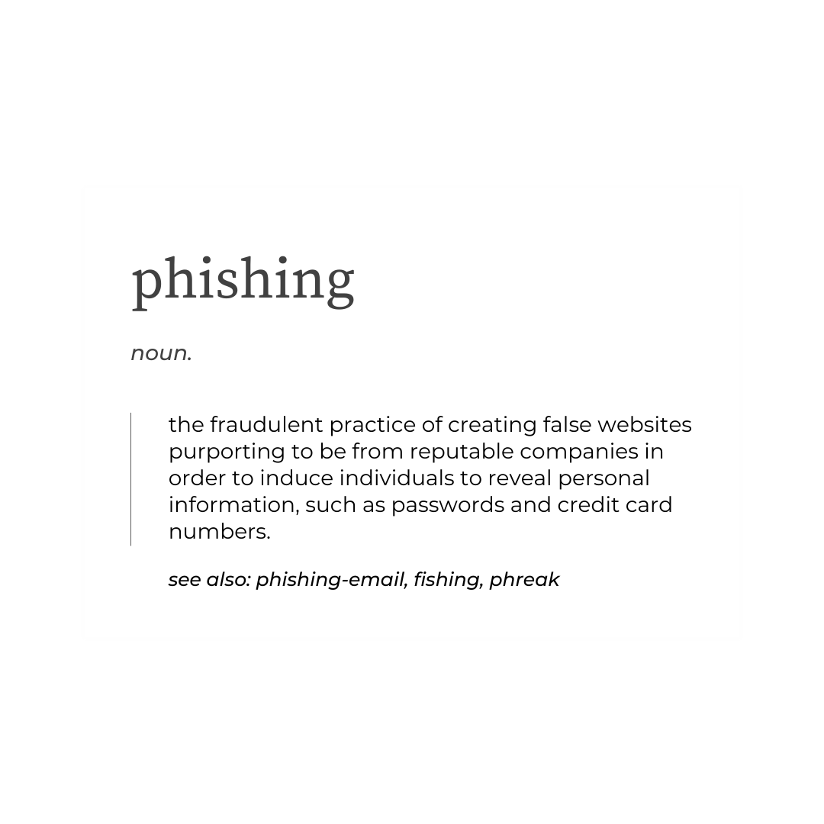

Slide 3
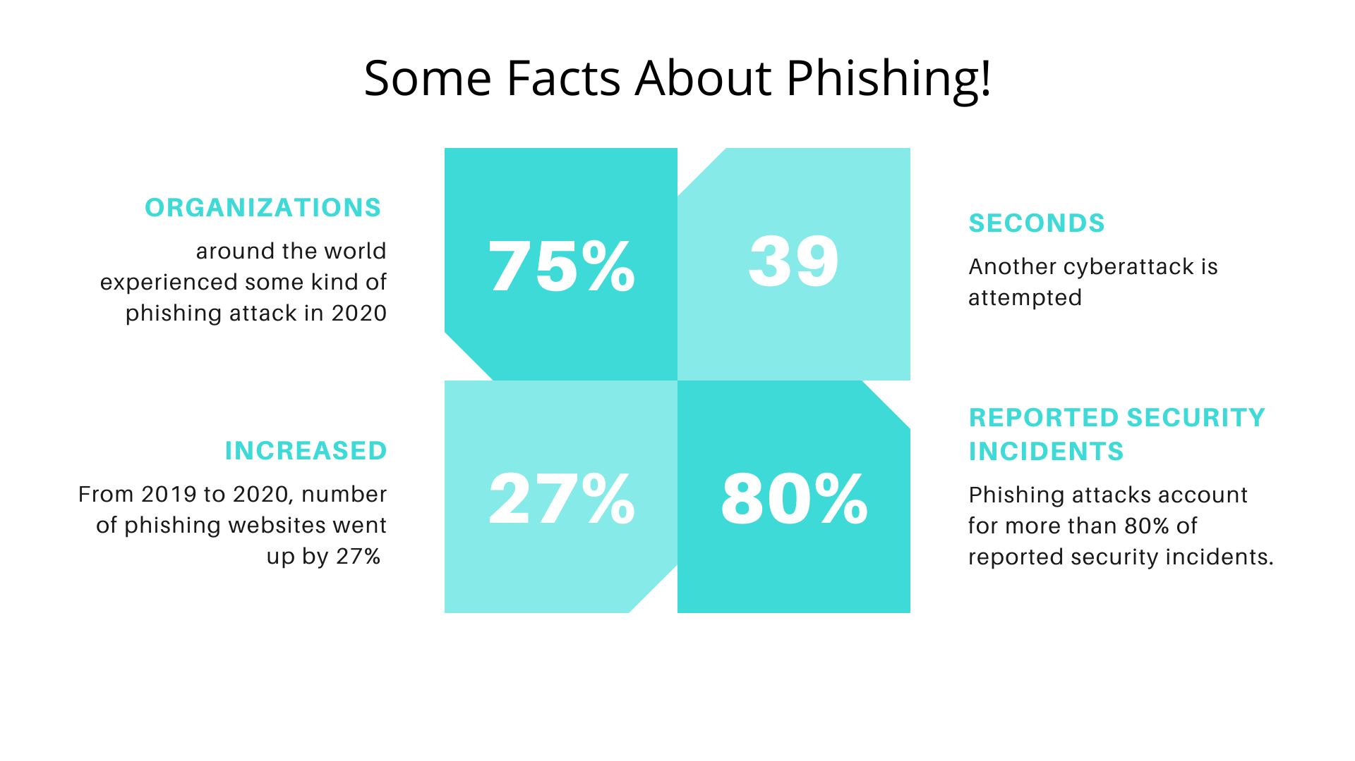

Slide 4
Problem Statement
Phishing is a prevalent issue in today’s Internet. It can have financial or personal consequences.
Thus, we developed a Phishing Game Website to educate people in accessing and checking URLs; i.e. enabling them to distinguish between trustworthy and non-trustworthy websites.
Phishers apply several URL spoofing tricks. Throughout several levels of the game, information about spoofing tricks is provided and phishing detection is exercised in a playful manner.

Slide 5
Technology Stack
Frontend:- HTML, CSS, JavaScript
Backend:- Flask, Pymongo, Jinja
Language: Python
Database: MongoDB
Version Control: Git
Deployment: Heroku

Slide 6
Spoofing Tricks covered in the Game
IP Address URL without Brand
Example: http://5.178.64.164/secure to impersonate PayPal.
Random/Unrelated/Trustworthy Domain, without Brand
Example: http://www.szuhsa.fr/login.html, http://www.weather.com/login.html or https://secure-payment.com to impersonate PayPal.
Random/Unrelated/Trustworthy Domain, with Brand in Subdomain
Example: http://paypal.mark-chippy.com/account-setup/ for Paypal or http://www.amazon.account.com/ for Amazon.
Random/Unrelated/Trustworthy/IP Domain, with Brand in Path
Example: http://onlinepayment.com/www.paypal.com/. This attack can also happen in combination with an IP address URL, e.g. http://5.178.64.164/paypal.

Slide 7
Spoofing Tricks covered in the Game
Derivated Domains
Example: facebook-login.com can be registered in order to impersonate facebook.com.
Introducing Typos
Example: The Phisher can register micosoft.com to impersonate microsoft.com or mircosoft.com to impersonate microsoft.com.
Replacing Character(s)
Example: https://www.arnazon.com to impersonate Amazon.

Slide 8
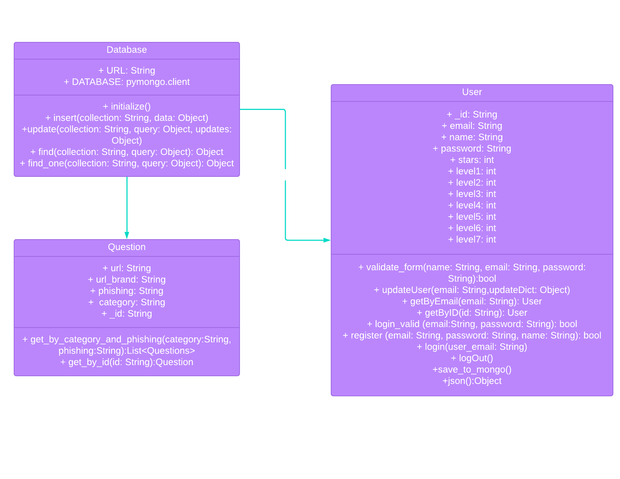
Class Diagram of the Project

Slide 9
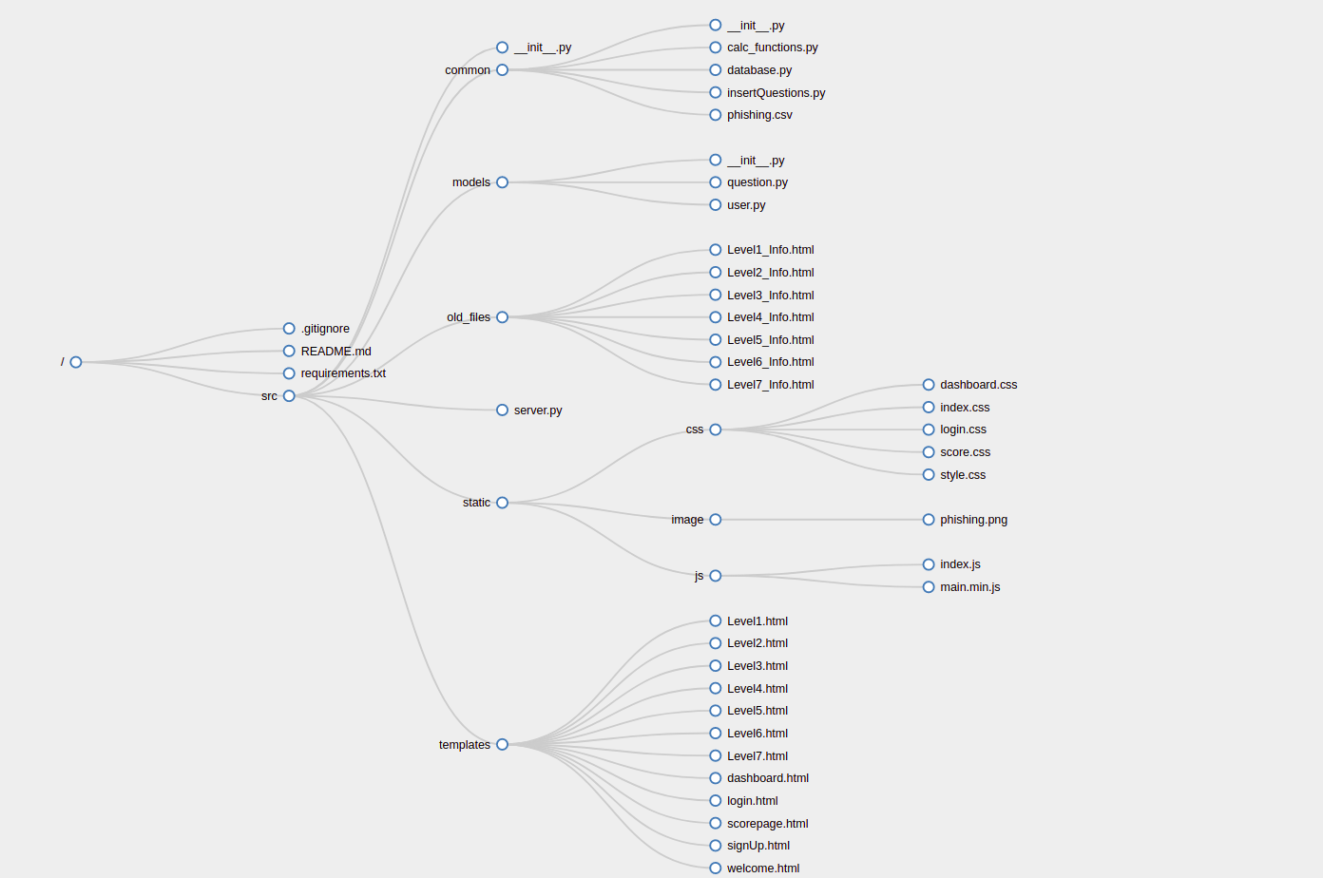
Directory Structure

Slide 10
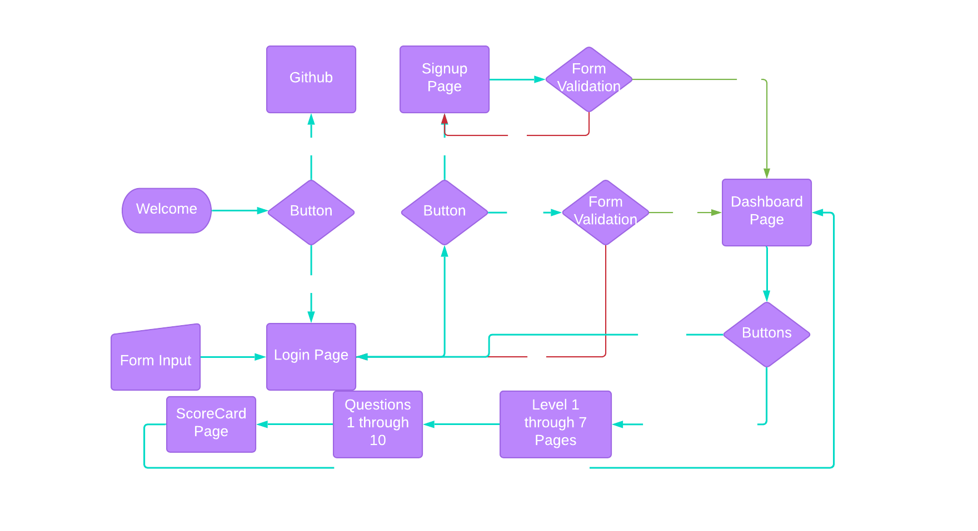
Flow Chart

Slide 11

Landing Page

Slide 12

Sign In Page

Slide 13
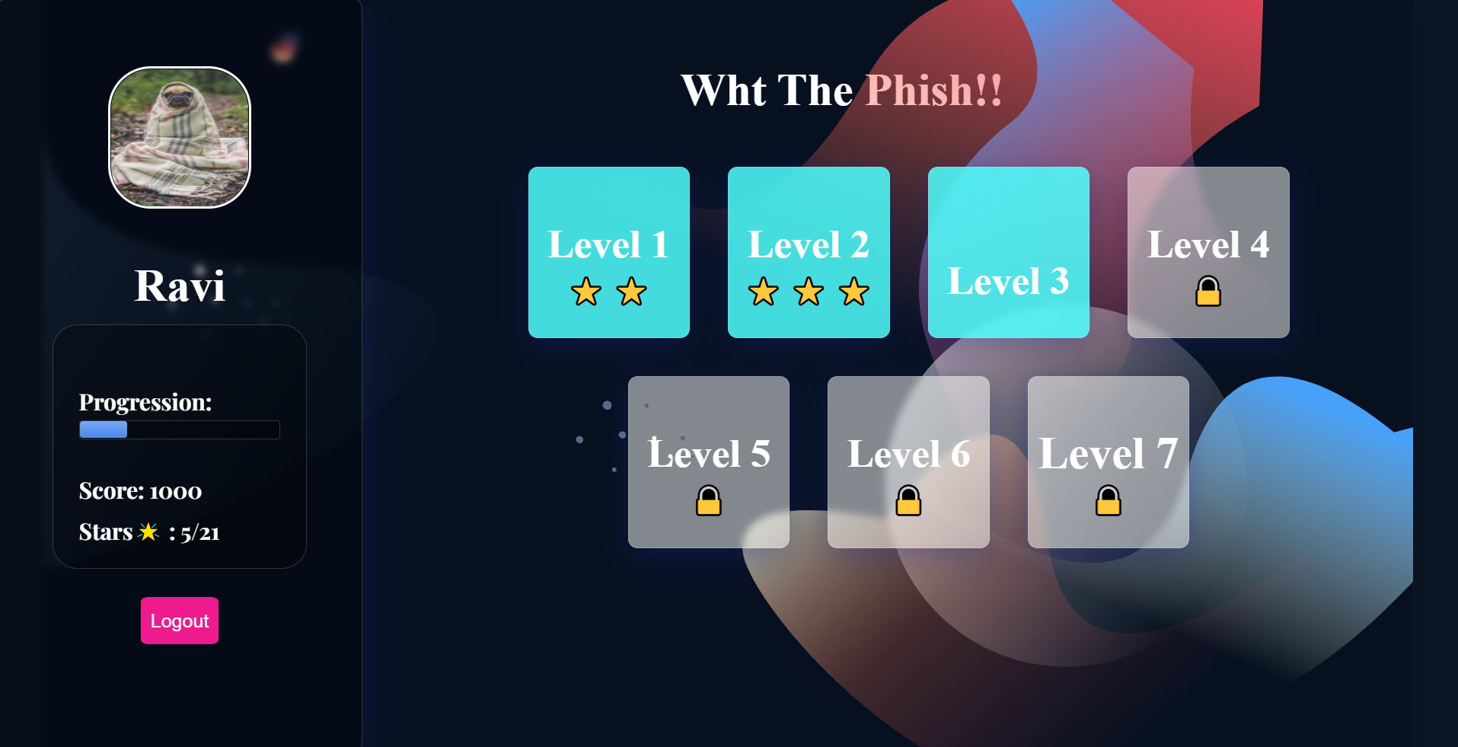
Dashboard

Slide 14
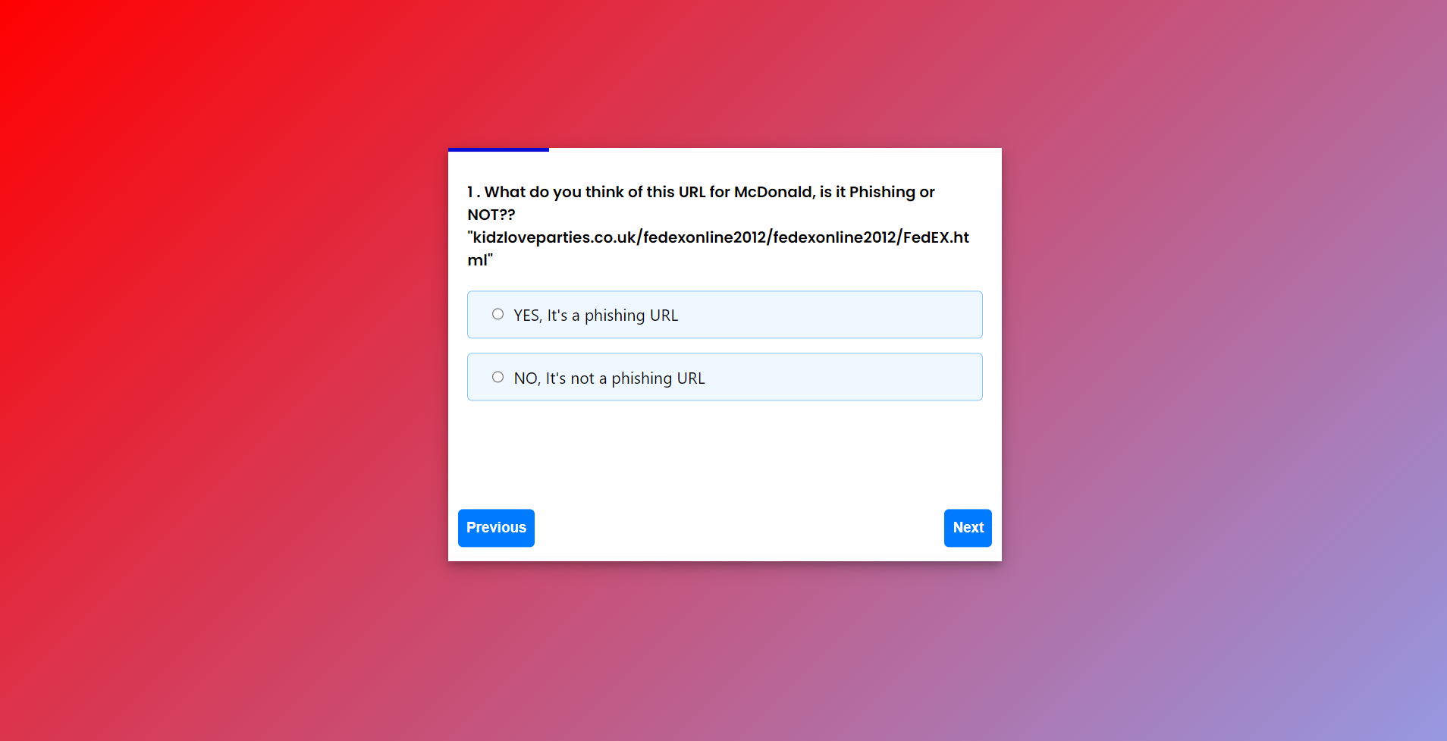
A Sample from Quiz

Slide 15
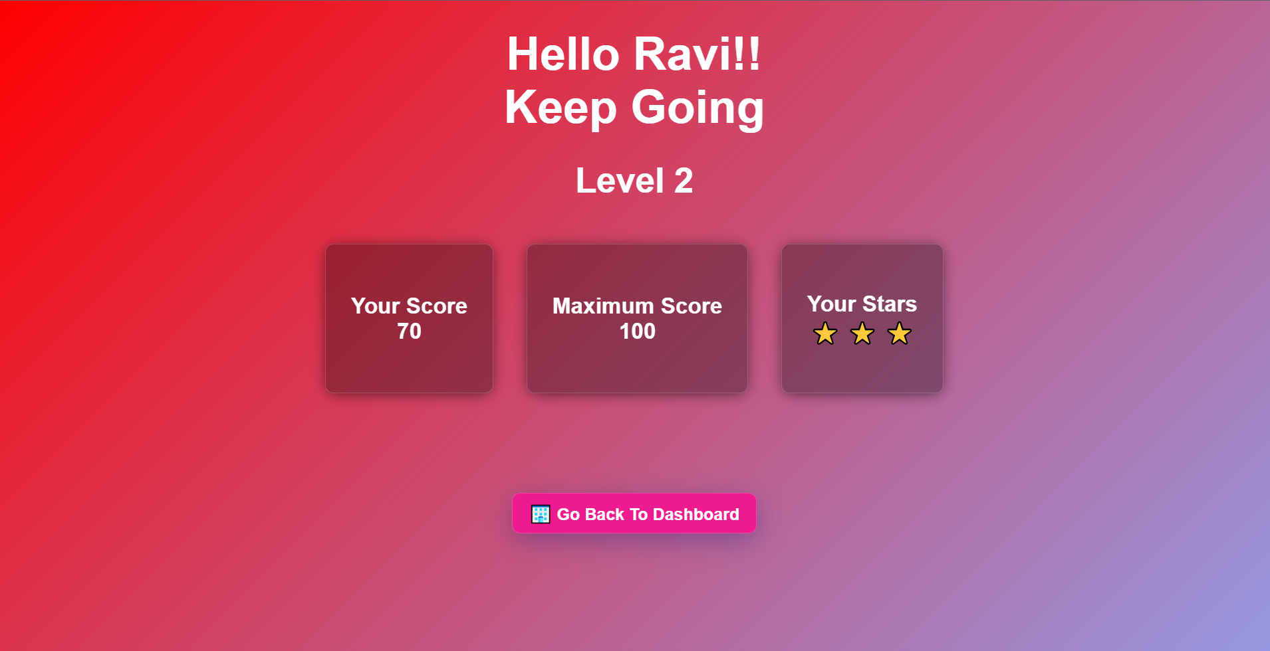
Score Card

Slide 16
THANK YOU

